Slide 1
CS 341 Lab 3
Fall 2020

Slide 2
Lab 3
writing a checksum function to check whether our configuration memory has been modified
Make use of bitwise operators

Slide 3
EEPROM Functions
EEPROM.read(int address)
EEPROM.write(int address, int value)
EEPROM.write(5, 0x41);
EEPROM.read(5); //returns ‘A’

Slide 4
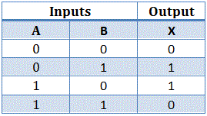
Bitwise Operators
operate on all numbers, but easiest to see how they work with binary numbers
Exclusive Or (also know as XOR)
0011₂ ^ 0101₂ = 0110₂
Logical Not (also known as compliment)
~ 0101₂ ₌ 1010₂
XOR

Slide 5
A Simple CheckSum Algorithm
Purpose: checking whether data was corrupted while downloading, transferring, etc
Works by performing an operation on some memory addresses, and storing the result to compare with later
CheckSum Algorithm
1010₂ ^ 1111₂ = 0101₂
0101₂ ^ 1100₂ = 1001₂
1001₂ ^ 0100₂ = 1101₂
~1101₂ = 0010₂
Index | Value
0 | 1010
1 | 1111
2 | 1100
3 | 0100
4
0010

